Slide 1
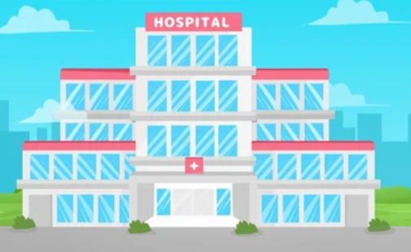
Power BI Project:
Columbia Asia Hospital

Slide 2

Agenda
Problem Statement
Data Description
Objective Key Metrics and Visualizations
Subjective Question for Insights

Slide 3
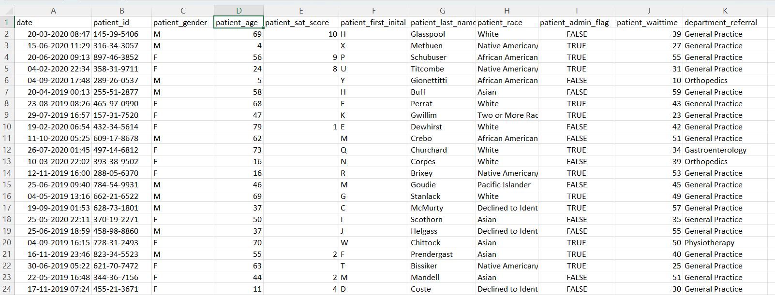
Problem Statement
You have been hired as a consultant data analyst by Columbia Asia Hospital. The Hospital is looking for key insights for the following objectives:
Assess the hospital's revenue generation
Insights about suitable departments for new hires
Strategies suggestions for patient discounts
Your task is to perform data analysis and come up with a report in order to help the organisation with the mentioned objectives.

Slide 4
The image above displays details about Columbia Asia Hospital data, including:
Date: This column contains date and time information without specifying AM or PM. The format is DD-MM-YYYY HH:MM.
Patient ID: Each patient is assigned a unique identifier, which seems to be in the format 124-62-3289.
Patient Gender: This column records the gender of the patient, denoted by 'M' for male and 'F' for female.
Patient Age: The age of the patients is listed in years.
Patient Sat Score: It seems to represent a satisfaction score given by or for the patient. However, the scores are single-digit, and it's not clear what the scale is.
Patient First Initial: This column contains the first initial of the patient's first name.
Patient Last Name: The surname of the patient is listed in this column.

Slide 5
Patient Race: The racial or ethnic background of the patient is recorded here, with categories such as 'White', 'African American', 'Asian', 'Native American/Alaska Native', and 'Two or More Races'.
Patient Admin Flag: This column contains boolean values ('TRUE' or 'FALSE') which might indicate whether the patient was admitted or some other administrative flag.
Patient Wait Time: Appears to indicate the time the patient waited, possibly in minutes, before being seen or processed.
Department Referral: This column lists the department to which the patient was referred, with entries such as 'General Practice', 'Orthopedics', 'Gastroenterology', or 'None' indicating no referral.
Doctor Name: Identifies the doctor who attended each patient.
Appointment Fees: The cost charged for a doctor's consultation.
Total Bill: The overall amount billed to the patient, including all services and charges.

Slide 6

Use this Link1 & Link2 for copying and then manipulating the dataset.

Slide 7
Submission
There is a series of tasks/questions mentioned ahead in the Project, in order to guide the candidates to have suggestions, insights for the Hospital.
You are asked to present a submitted PPT file to the management for the story telling and suggestions in order to complete the objectives.
The submission Zip file should consist of the following three documents:
Power BI File (.pbix) (consisting of dashboard)
Document File (.docx) (consisting of Answers and suggestions for Objective and subjective questions)
Presentation File (.pptx) (consisting of the presentation which you want to present to the management)

Slide 8
Tasks
…Tasks in order to help in completing the objectives

Slide 9
Objective Questions
In analyzing the hospital dataset with Power BI, ensure data cleaning to address inconsistencies and missing values before further analysis.
Assess the Average Waiting Time: Analyse the patient wait times to identify the average duration a patient spends before receiving care.
Visits by Department Referral: Calculate the total number of visits to each department based on referrals to understand which departments are most frequently visited.
Patient Visits by Age Group: Segregate patient visits according to different age groups to see which demographics utilize healthcare services the most.
Were there any Null values in the data? What would be the best way to handle these Null values and which approach have you opted?
Is there any relation between the number of visits and Gender of the patients.
Average Satisfaction by Demographics: Determine the relationship between patient satisfaction scores, their age groups, and racial backgrounds to pinpoint areas for improvement in patient experience.
Using ‘Calculate’ and a row iteration DAX function calculate the total number of patients who have visited Dr. Smith.

Slide 10
Objective Questions (Cont..)
9. Which department is charging the highest appointment fees in general? Use an aggregation DAX function to solve this question.
10. Create a tabular visualization in the Report view which consists of Month-wise total visits in the hospital. Add a third column in the table that consists of the previous month’s total visits for each month’s row. Also include a column which states whether the visits in a month is greater than that of previous month visits.
11. The hospital's managing director seeks to evaluate the revenue of each department to understand how much revenue is generated by each.
12. Calculate the average age of the patients who visit the Orthopedics department. Will the approach used to calculate this metric be different if the requirement would have been all department’s average age.
13. Were there any data format issues in the data, and if there were/are how you handled them?
14. When we add a column in Power Query what’s the code that comes in M language in formula bar? What do you know about M-query?

Slide 11
In order to answer the next data analysis questions you will have to create report and visualizations.
For answering these questions you need to properly analyze the data through summarization, report and visualizations to give the insights.
Back your suggestions/insights with proper reasoning considering the data and reports.

Slide 12
Data Analysis and Visualizations (Subjective Questions):
1. What is the relation between patient wait time and satisfaction scores?
• Investigate whether longer wait times are associated with lower patient satisfaction across various departments.
2. How do patient demographics affect the frequency of visits to different departments?
• Analyze visit patterns to see if certain age groups or races are more likely to be referred to specific departments.
3. Is there a noticeable trend in the volume of patient visits throughout the year?
• Examine patient visit data to identify any seasonal trends or particular months with increased healthcare facility usage.
4. Which age groups report the highest and lowest satisfaction scores?
• Calculate the average satisfaction scores within each age group to identify which age demographics report the best and worst experiences.
5. Say if someone outside of hospital claims that there is racial or gender based discrimination in the hospital, how will you identify whether the claim was right or not?

Slide 13
Data Analysis and Visualizations (Subjective Question) - (Cont…)
6. The hospital management intends to offer discounts to patients.
The question arises: how should these offers/discounts be assigned to patients, on what basis, and why?
7. The hospital has a budget to hire 2-3 new doctors.
They have asked for your suggestions in which departments they should hire.
8. Is the hospital profitable? How will you determine the profitability?
9. Any Department for which the waiting time is oddly large?
10. Come up with the strategies to provide discounts to the patients.
11. Say if you need to align the doctors of “General Practice” department to work in one of the two shifts, how will you identify what will these two shifts timings be, and how will you divide the doctors in these two shifts? And also will this 2 shift policy be helpful for the hospital?
12. What do you understand by PowerBI gateway? What are its use cases?

Slide 14
Data Analysis and Visualizations (Subjective Question) - (Cont…)
13. How would you approach this problem, if the objective and subjective questions weren't given?
14. Can you analyze and write the type of relationship between the doctor id and department, is it one-to-one?

Slide 15
Report Requirements:
The hospital has asked for a report with three tabs:
Main Tab
Doctors’ Tab
Patients’ Tab
Using the Main tab in the report, hospital should be able to look at the overall metrics like number of daily visits, revenue produced on that day, customer satisfaction, how busy are different departments on that day and general waiting time on that day. This tab should have a slicer of date.
Using the Doctors’ Tab, the Chief Of Staff at the hospital should be able to look at the individual doctor’s performance metrics like customer satisfaction, number of patients he was visited by, revenue he has generated, his appointment fees. This tab should have a slicer of Doctor Name or ID.

Slide 16
Report Requirements (Cont..) :
Using the Patients’ Tab, the Patient’s Care Chief at the hospital wants to look at a customer’s profile which would involve metrics like most frequently visited department, their age, their race, their waiting time, number of visits, total amount that they have paid to the hospital etc. Basically all the metrics using which they can address the patient very carefully in their visits. This tab should have a slicer of Patient Name or ID.
Make sure that all the visualizations look decent and are placed in a proper order. There are different POCs (Point Of Contact) for each tab, so make sure you involve all the metrics that POC may look at in that tab along with those mentioned in the tab description.
Also ensure using Field parameters in the report.
After making the report on Desktop ensure that its hosted on PowerBI service and use the hosted link for submission of dashboard and mentioning on resume.

Slide 17
SUBMISSION DEMONSTRATION
Refer to the video released in the batch
One can use this Link in order to understand the sample
approaches for each section of the project.

Slide 18
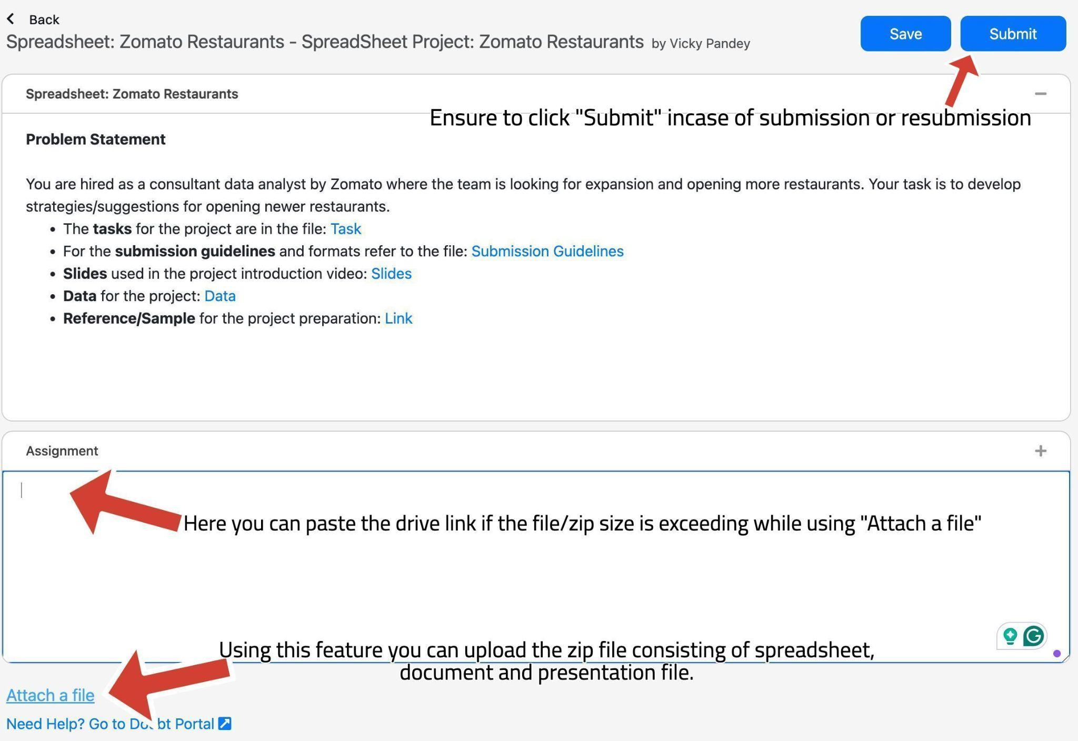
Submission UI
The submission UI can be changed a bit from the video, kindly refer here.
Look at the arrows and the comments to get familiar with the UI while submission and uploading the files on the platform. There is a space to paste the drive link and upload the zip file.

Slide 19
SUBMISSION FLOW
The candidates are supposed to have the first submission for the project within the 10-day deadline
After the submission, candidates will receive feedback on their project, which they are supposed to incorporate and re-submit within 1 week of feedback.
All the candidates are supposed to get a total of 8 marks to be prioritized in placements since is is necessary in Placements.
The re-submissions after 3 weeks of launch in the batch will be de-prioritised for evaluations.
Candidates will have to give the reason for their delay, in order to make sure that team picks up their evaluation.
This will create backlogs as the project for next module will also be releasing around the same time.
So make sure to submit the project (with the requirements) within timeline.

Slide 20
GUIDELINES:
Ensure to submit the project within the deadline.
TA support won’t be answering any direct questions regarding project.
Plagiarism will be checked during evaluation.
Queries regarding submission should be asked to success champions.
Candidates must score >=8 out of 10 in order to be picked for referrals.

Slide 21
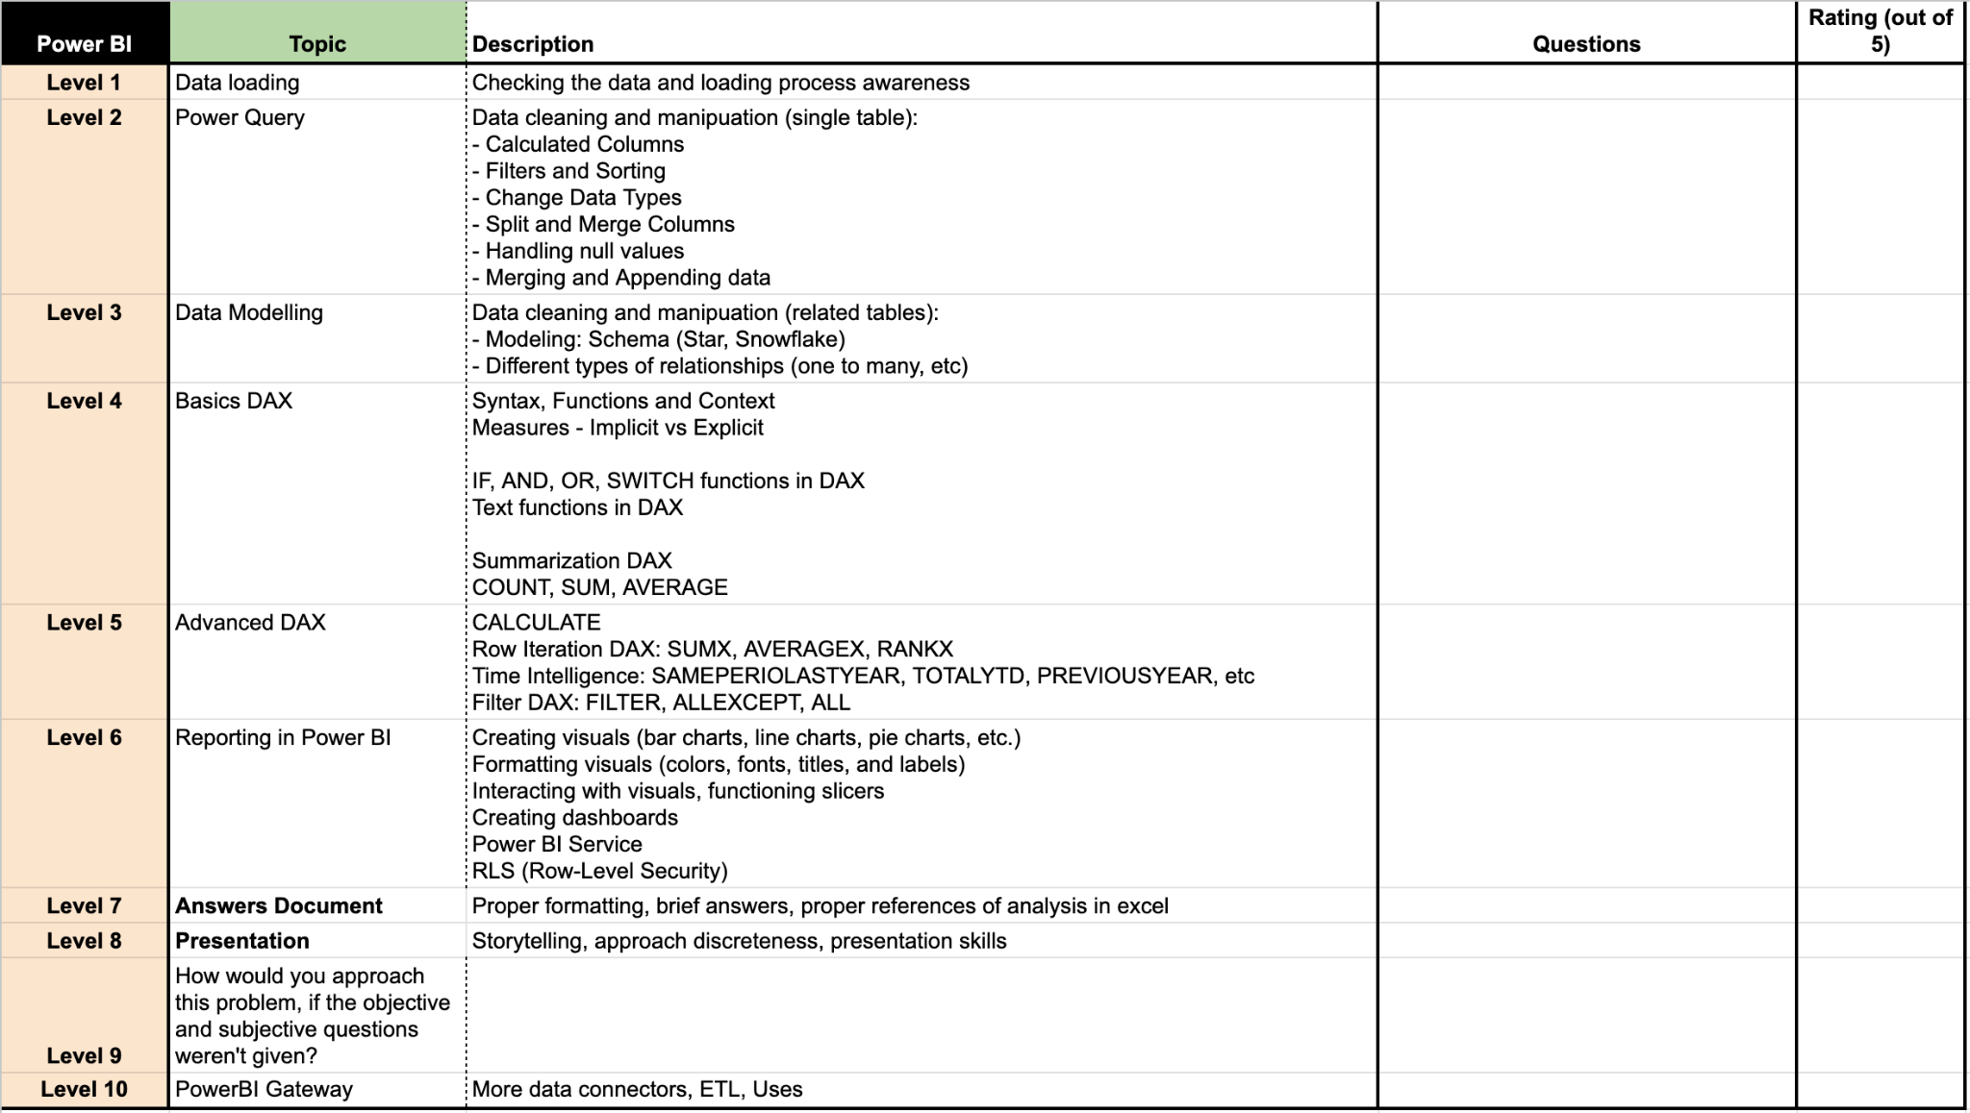
EVALUATION
The projects will be evaluated on 10 levels (Each learner will receive a detailed feedback).
On each level, learners will get a rating out of 5 and if the rating is smaller than 4, he won’t be considered as passed at that level.
Learners have to get >=4 (or passed) in at least 8 levels to get >=8 as the final rating in the project.
In the final feedback, only the final feedback out of 10 will be considered.
The ratings of level 9-10 will only be considered and included in the final feedback if someone is passing in all the Levels from 1 - 8. They (levels 1-8) are compulsory, in order to get passed in the final feedback.

Slide 22

Don’t forget to post this project on LinkedIN with the hosted links to make your profile stronger.

